Slide 1
RhythmiQ Music app
Team Name:- CodeJee
Team Number:- 5
Team Members:-
Rahul Chaudhary 2210990703
Prabhjot Singh 2210990658
Puneet Chauhan 2210990691
Priyanshu Gupta 2210990687

Slide 2
Index
Objective
Introduction
Methodology, Approach & Techniques
Algorithm
Flow Chart
Result
Source Code (screenshots)
Conclusion
Reference

Slide 3

Objective
The Objective of the RhythmiQ is to design and develop a user friendly and feature-rich music player application using HTML, CSS and JavaScript. The application should allow users to easily browse and play their favourite songs, create playlists, and customize the playback settings. The project aims to provide a seamless and enjoyable music listening experience for users.

Slide 4
INTRODUCTION
Purpose
The purpose of this music player application project is to create a user-friendly and visually appealing platform for users to listen to their favorite music. The application will provide a seamless and enjoyable music listening experience.
Background
In today’s digital age, music streaming has become increasingly popular. People are constantly looking for convenient ways to access and enjoy their favorite songs. This project aims to meet that demand by developing a music player application that offers a wide range of features and a user friendly interface.

Slide 5
METHODOLOGY
Agile Development
We followed an agile development approach to ensure flexibility and adaptability throughout the project.
User-Centered Design
Our development process prioritized the needs and preferences of the users, ensuring an intuitive and enjoyable music player experience.
HTML, CSS and JavaScript
We utilized HTML, CSS and JavaScript to create the music player application, leveraging their capabilities to deliver a seamless and interactive user interface.

Slide 6
APPROACH
HTML
Utilized HTML to structure the content of the music player application.
Created separate HTML files for different sections of the application such as the main player, playlist, and settings.

Slide 7
CSS
Styled the music player application using CSS to enhance the visual appeal.
Implemented custom CSS styles to create a cohesive and visually appealing user interface.
JavaScript
Utilized JavaScript to add interactivity and functionality to the music player application.
Implemented functionalities to handle user interactions such as audio playback.

Slide 8
TECHNIQUES
HTML:
Used to structure the web pages of the music application.
Semantic elements for better accessibility.
CSS:
Styled the user interface using CSS to create an attractive and intuitive design.
Flexbox for responsive design and utilized CSS animations and transitions to enhance the user experience.
JavaScript:
Used JavaScript to handle user interactions and control the audio playback.
Used JavaScript for user registration and login feature.

Slide 9
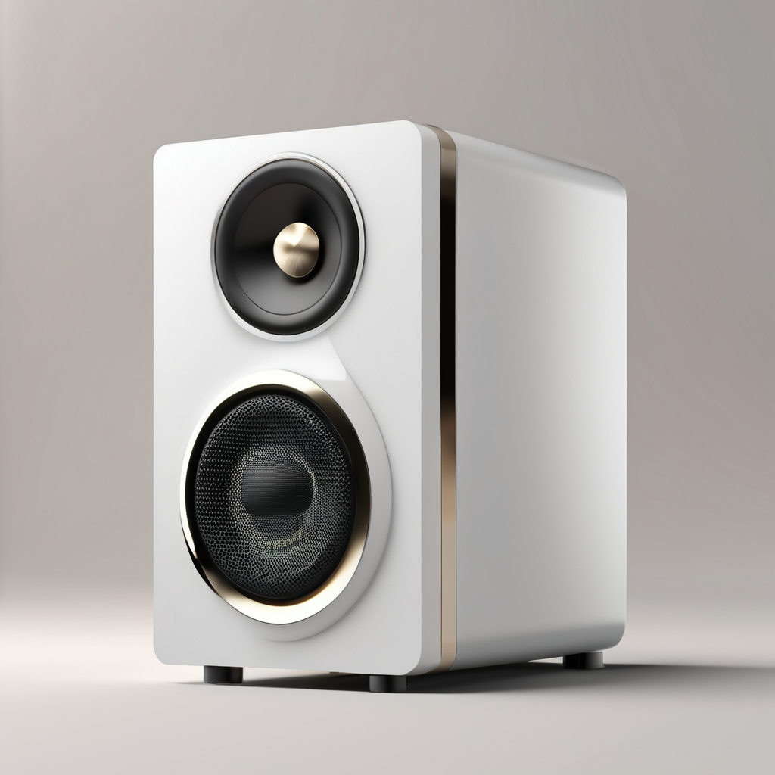
ALGORITHM
MUSIC PLAYBACK
The application uses an algorithm to play the selected song. The
Algorithm retrieves the audio file from the database and streams it to the users device.
LOGIN VALIDATION
The application uses an algorithm of login validation on the login page which states that user has to login with his credentials to proceed further in the application.

Slide 10
FLOW CHART
User will have to first create login id to use the application.
Login is mandatory to use the music application.
After login user will be forwarded to main page.
User will have access to multiple features.
User will have access to multiple songs.
User will have access to contact us page if faces any issue.
Can make it’s own playlist named as “My Playlist”.

Slide 11
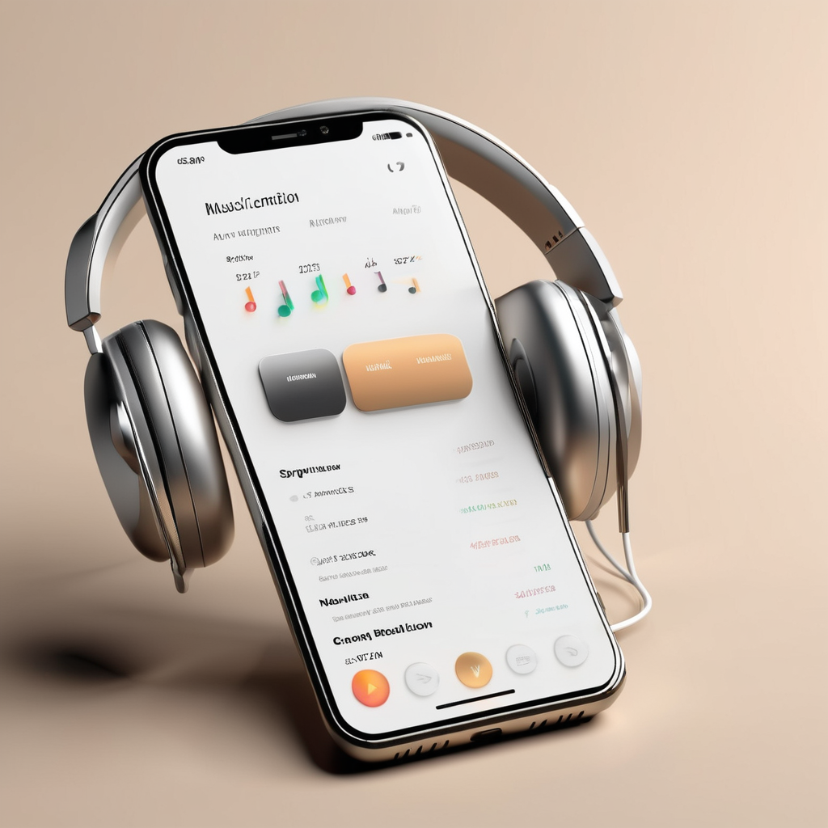
RESULT
The music player application is built using HTML,CSS, and JavaScript, ensuring a smooth compatible application.
The application is lightweight and optimized for fast loading and smooth performance.
The Audio Playback is seamless and does not experience any lag or buffering issues.
The application is designed to consume minimal system resources, ensuring efficient performance.

Slide 12
CONCLUSION
Key Findings
The music player application project successfully implemented the core functionalities of playing and playback of songs.
The HTML, CSS and JavaScript languages were effectively used to create an interactive and user-friendly interface.
The project provided an opportunity to practice and improve coding skills in front-end web development.

Slide 13
LESSONS LEARNED
Working on this project enhanced understanding of HTML, CSS and JavaScript concepts.
Collaboration and teamwork skills were developed through working with a group of peers.
Debugging and troubleshooting skills were honed by identifying and fixing issues in the code.

Slide 14
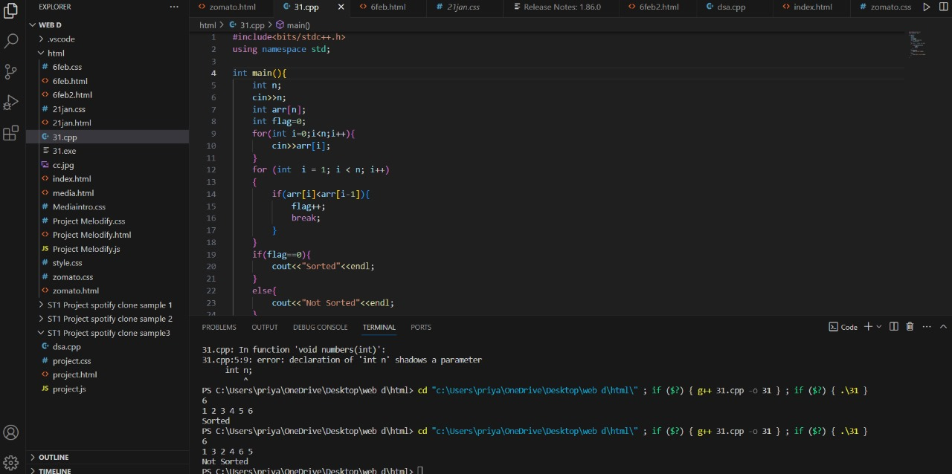
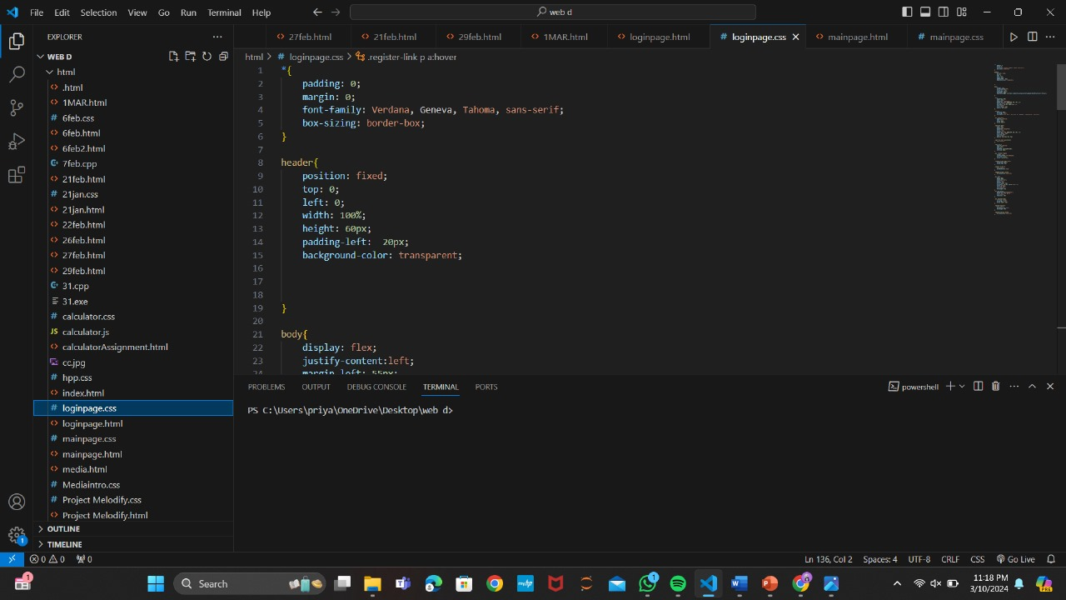
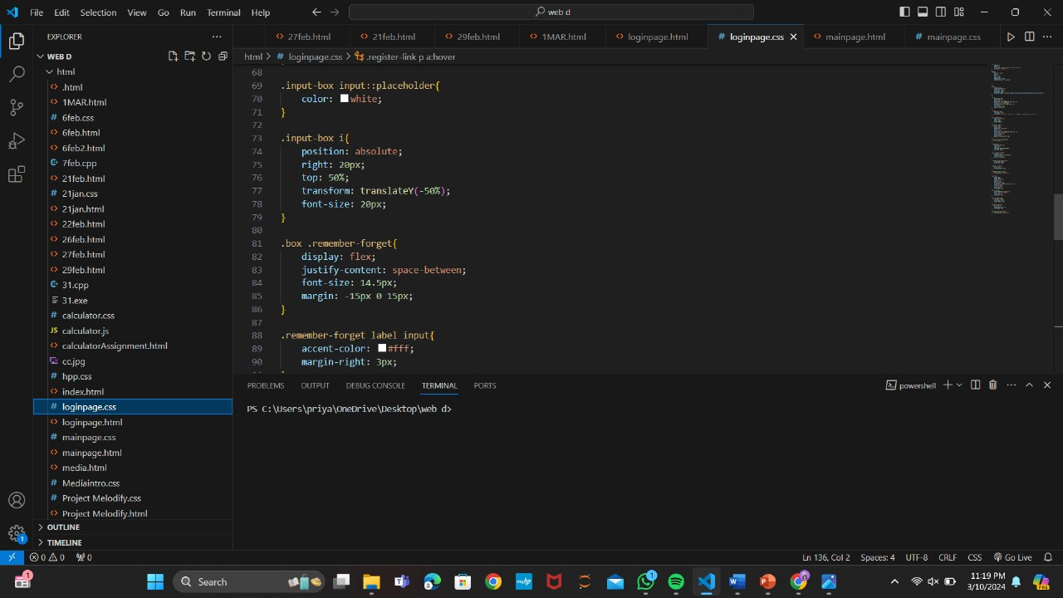
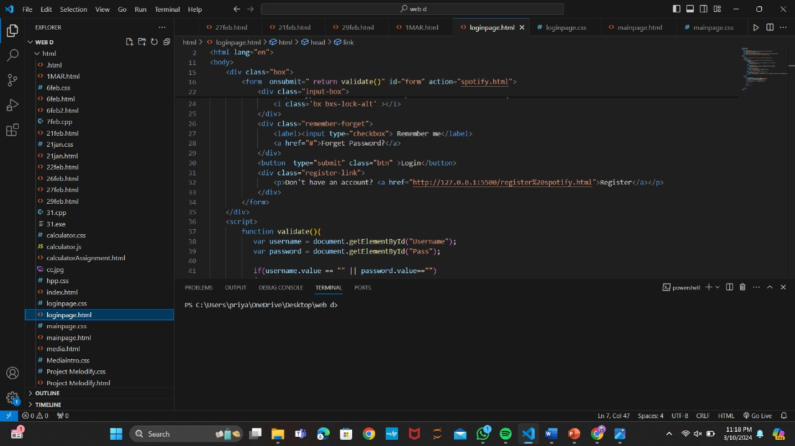
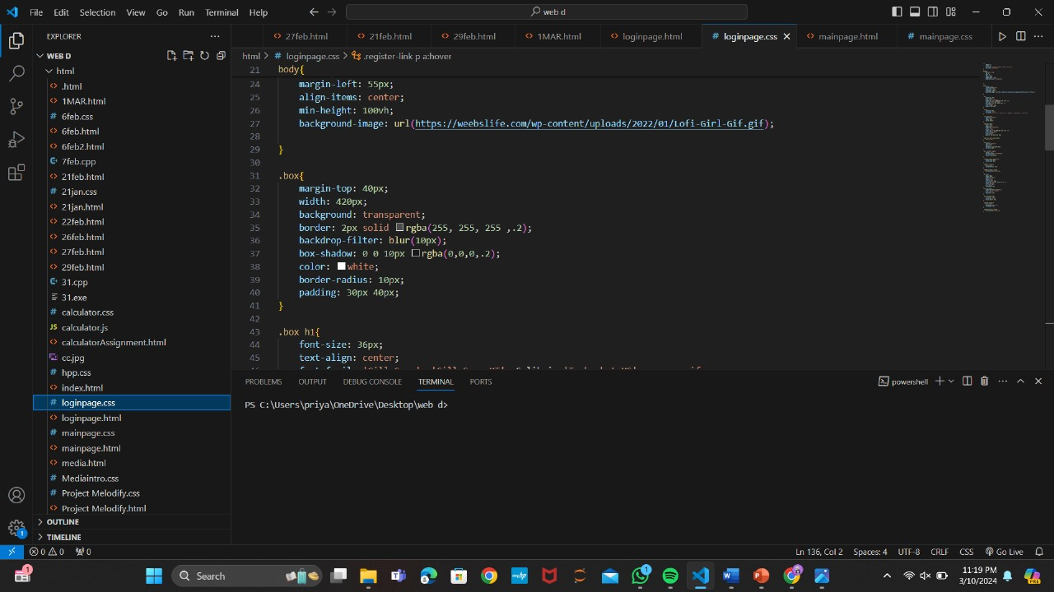
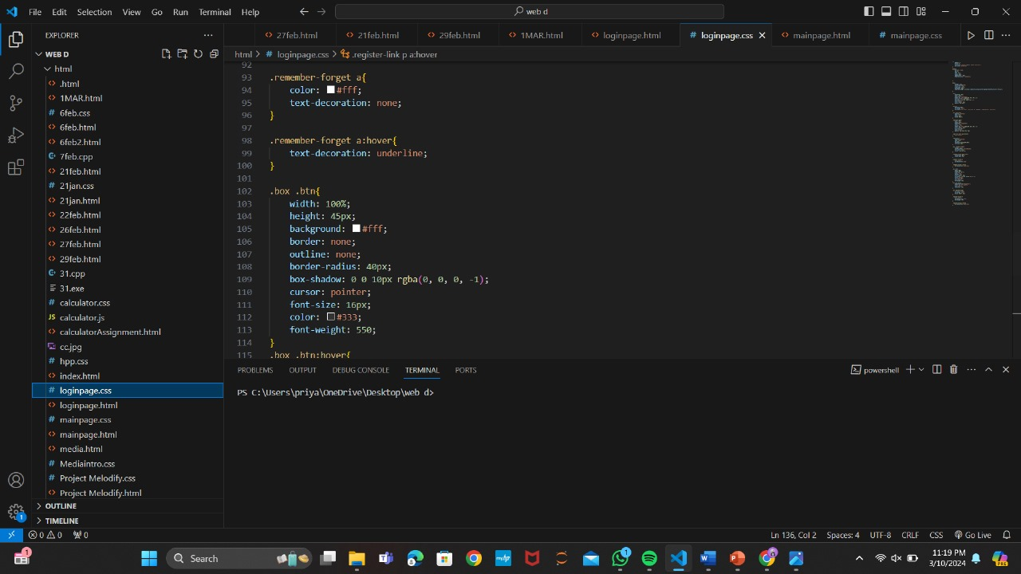
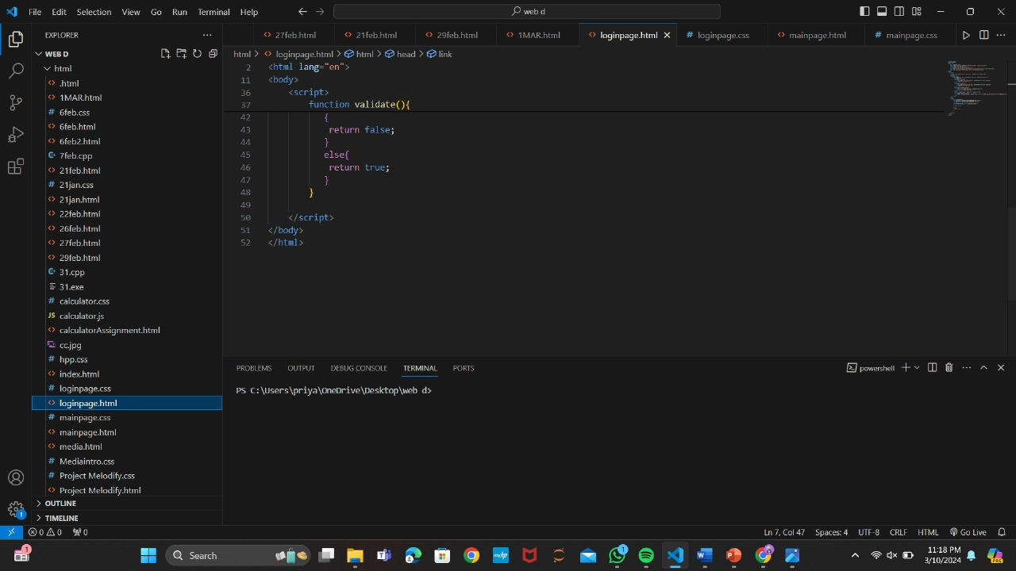
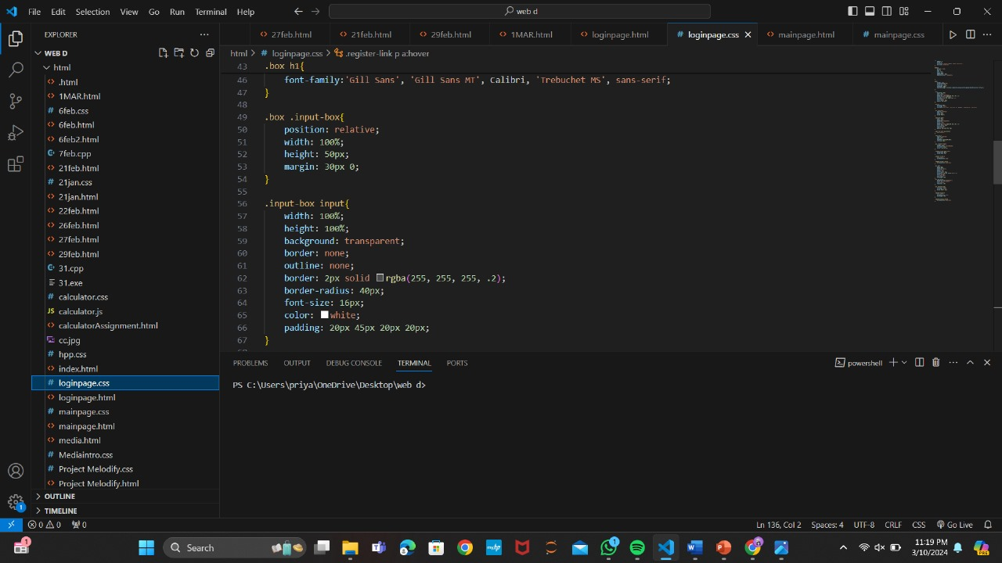
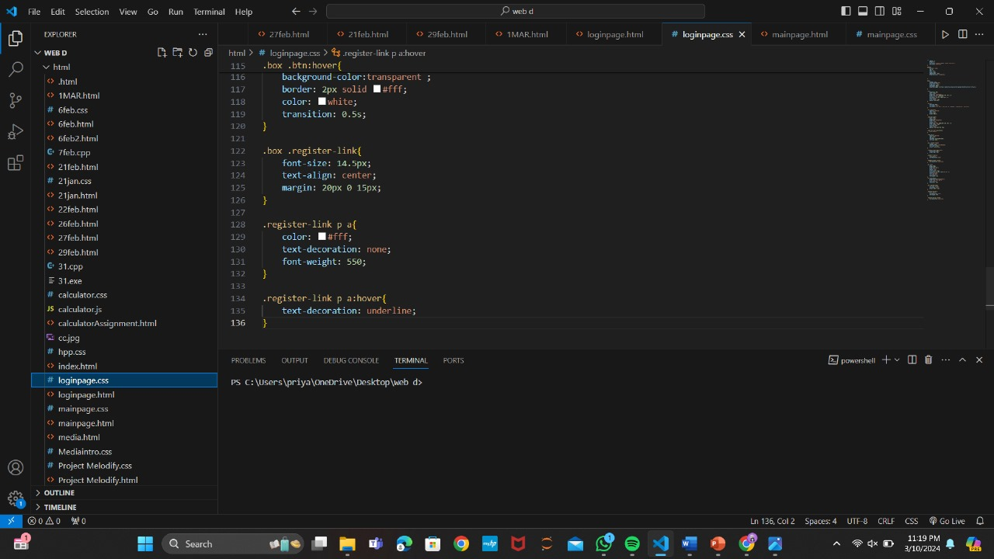
SOURCE CODE

Slide 15
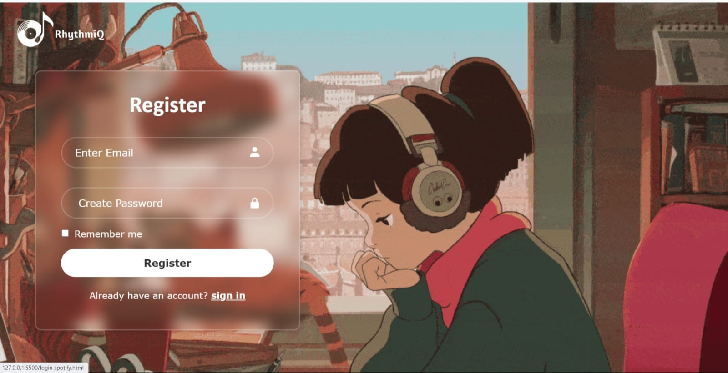
REGISTER PAGE

Slide 16
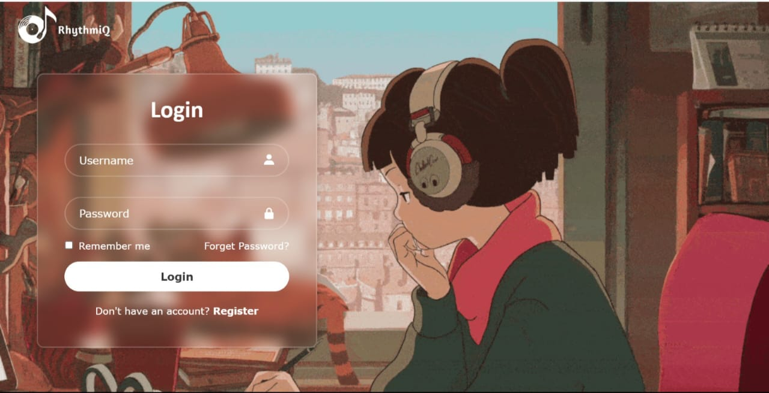
LOGIN PAGE

Slide 17
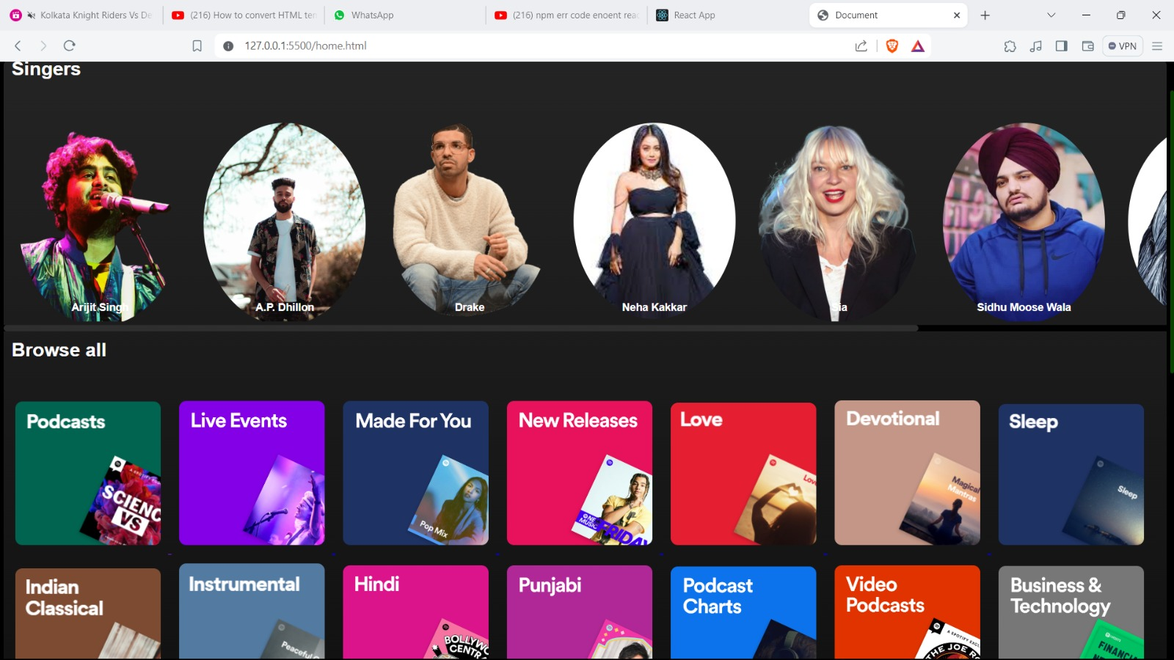
Home Page

Slide 18
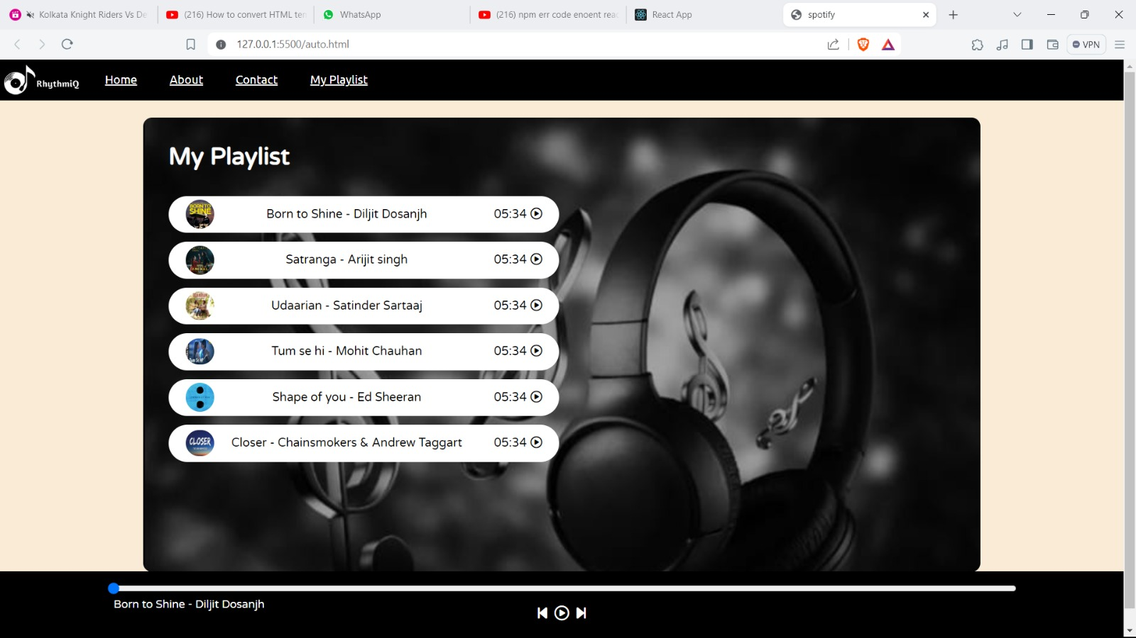
My PLaylist

Slide 19
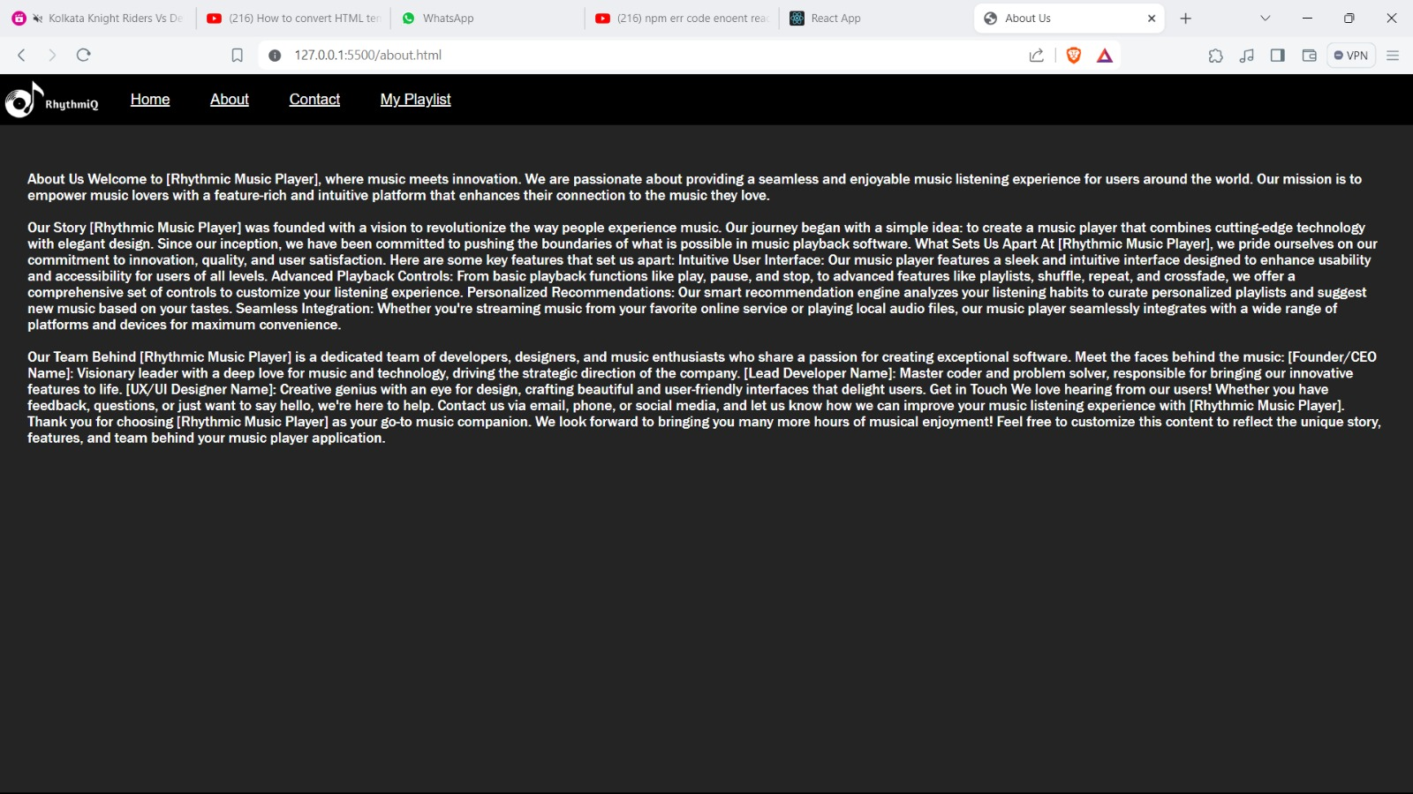
About Us Page

Slide 20
REFERENCE
https://unpkg.com/boxicons@2.1.4/css/boxicons.min.css
https://cdnjs.cloudflare.com/ajax/libs/font-awesome/6.1.1/css/all.min.css
"https://media.newstrack.in/uploads/entertainment-news/regional-cinema-news/Sep/05/smallthumb/DILJIT_5f534efb2e3a9.JPG" alt=
https://i1.sndcdn.com/artworks-000391673679-jic1uu-t500x500.jpg

Slide 21
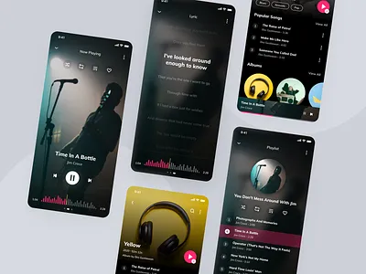
The End

